Slide 1
MOBILE ROBOTICS PROJECT
Developing Raspberry Pi Based Obstacle Avoiding Mobile Robot Guided By Computer Vision For Door Recognition

Slide 2
Contents
Mobile Robot Specifications
Image processing introduction
MATLAB Computer Vision Toolbox application
Study of various approaches in OpenCV and results
Analyzing motion of the robot
Ultrasonic sensor for obstacle avoidance
Video Segment
Challenges in deploying the robot in the corridor and Optimization of the code to overcome hardware difficulties
Miscellaneous problems
Conclusion
Future Scope

Slide 3
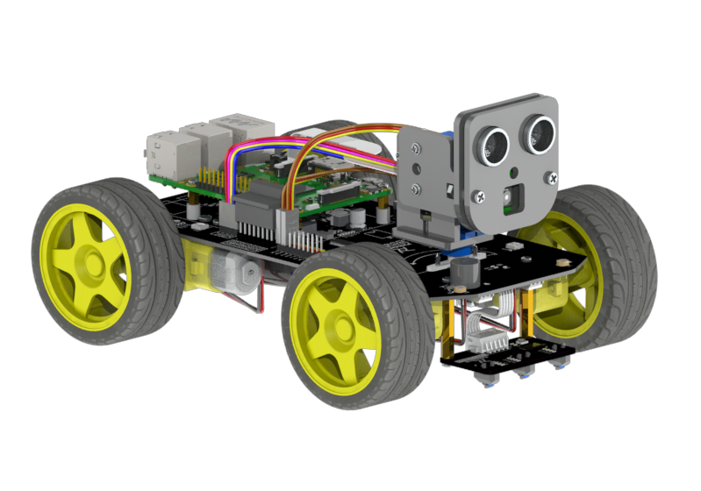
Mobile Robot Specifications
Ready to assemble mobile robot from Freenove (Raspberry Pi based)
Controller – Raspberry Pi 4B
Camera – Pi Camera module V1 (Included within the robot hardware package)
Dual Servo Motor Mount – for swivel motion of the camera head (pan/tilt)
4x DC motor – for motion of the robot (without encoders)
Ultrasonic Sensor
[Fnv22]

Slide 4
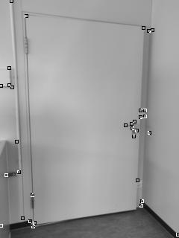
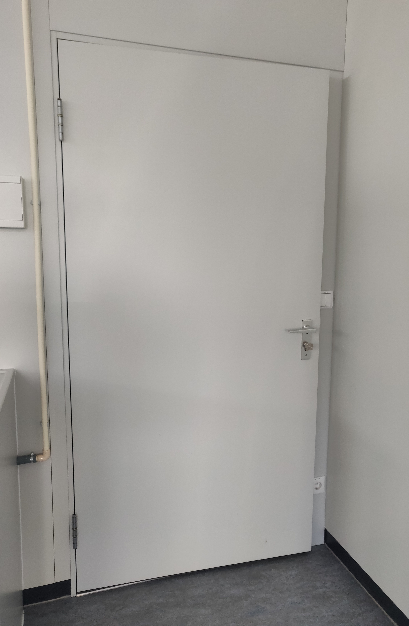
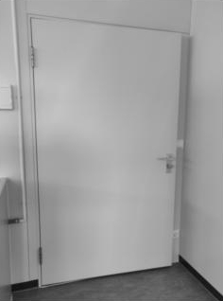
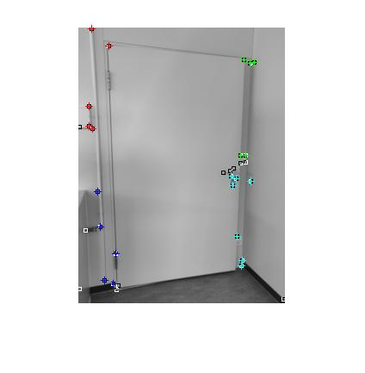
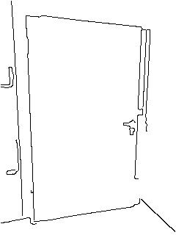
Steps in Image Processing
Image acquisition
Pre-processing
Feature extraction
Post-processing
Pre-processing
Feature extraction
Post-processing
[Jcr98]

Slide 5
MATLAB Computer Vision Toolbox
Provision of various functions and algorithms required for image acquisition, pre-processing, analyzing, post-processing and storage.
Easy to use and constantly under development for incorporating new algorithms.
Disadvantages of installing MATLAB on Raspberry Pi:
It supports and old version of MATLAB which may not cover the latest image processing library.
It takes around time in running algorithms and makes the process very slow. In some cases, the speed ratio may reach 80. [OcvM20]
Need for translation of python code to MATLAB for robot motion that is provided from the manufacturer.

Slide 6
Pre-Processing, Analysis and Post-Processing
The image was first converted to grayscale and resized to a suitable resolution (Image Pre-processing) which simplifies the problem to a contrast based approach with 1-dimensional values.
Then a corner detection algorithm was applied which detects corners based on the edge map it creates.
The idea at post-processing was to estimate corners in a given image and apply door characteristics on the obtained corners. This could be understood in steps as:
Group 4 corners out of the obtained corners based on the quadrant they are in as a candidate for corners of the door.
Find lengths of all the 4 sides of the chosen pair and their absolute tilt about x-axis. If they are within a specific tolerance, the 4 points are actually a candidate of representing a door.

Slide 7

Images from Analysis (Corner Detection) in MATLAB

Slide 8
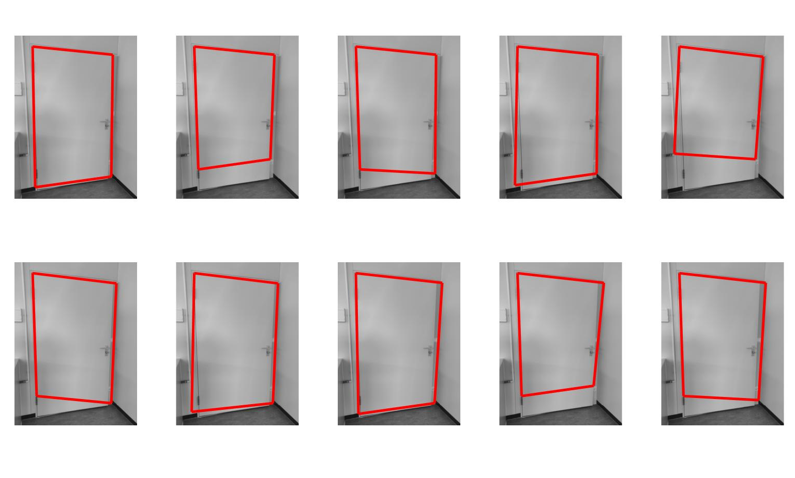
Post-Processing Results

Slide 9
Open CV on RPi
Since the program was to be deployed on the Raspberry Pi eventually, the first though was direct deployment of MATLAB code on the board using the Code Gen add-on from MATLAB. But the bugs could not be fixed as there were many functions and code bits which could not be directly translated to C++/Python. E.g. It doesn’t allow increase of array size every loop.
OpenCV was the most used library for deploying image processing programs on RPi. Unfortunately the corner detection function which was used in MATLAB could not be translated directly into OpenCV. Thus using Harris Corner Detection with Python was the obvious choice initially.
Also, since the robot was available with power now, the images used now were from the Pi Camera.

Slide 10
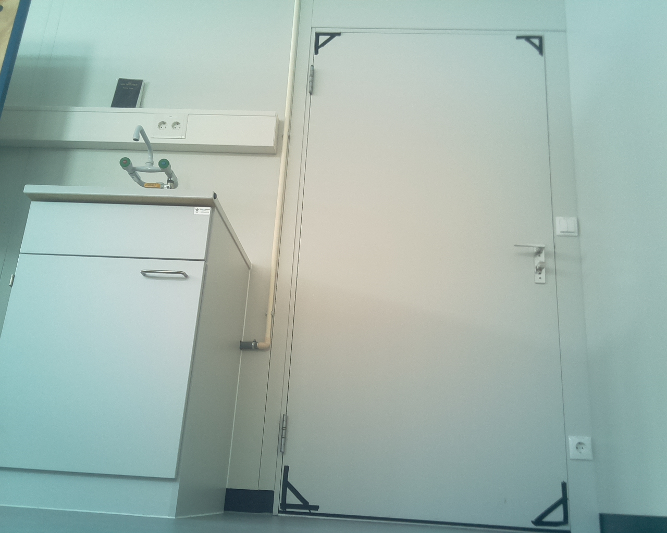
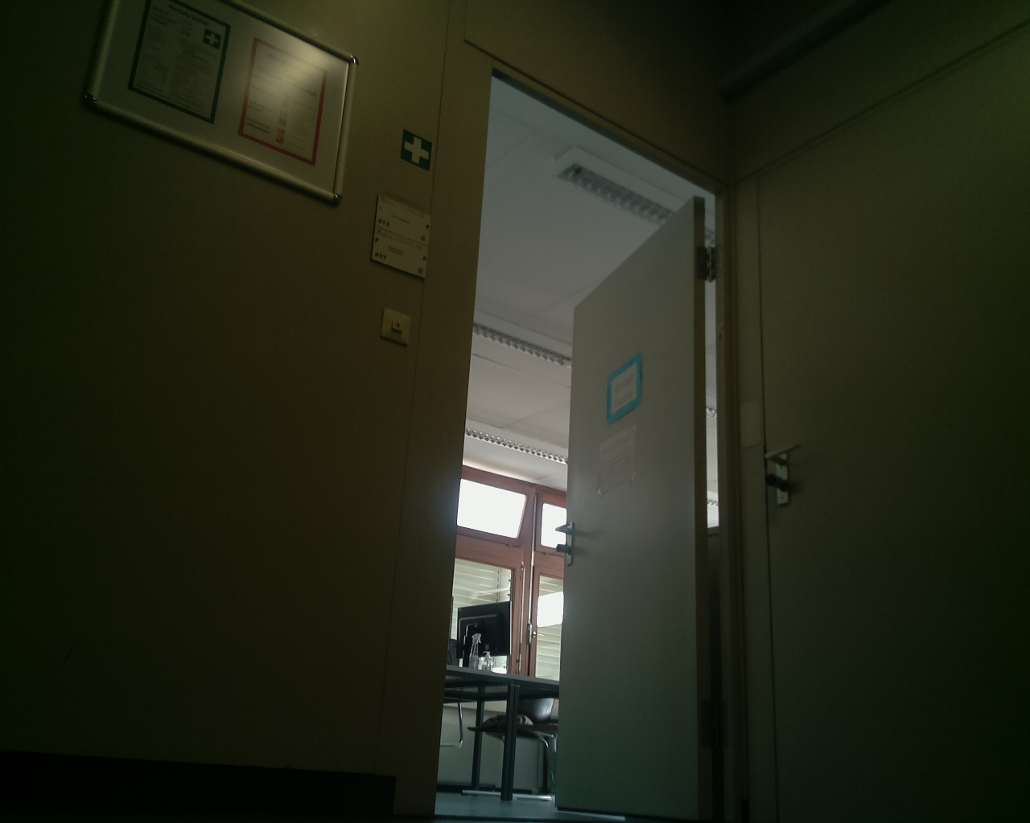
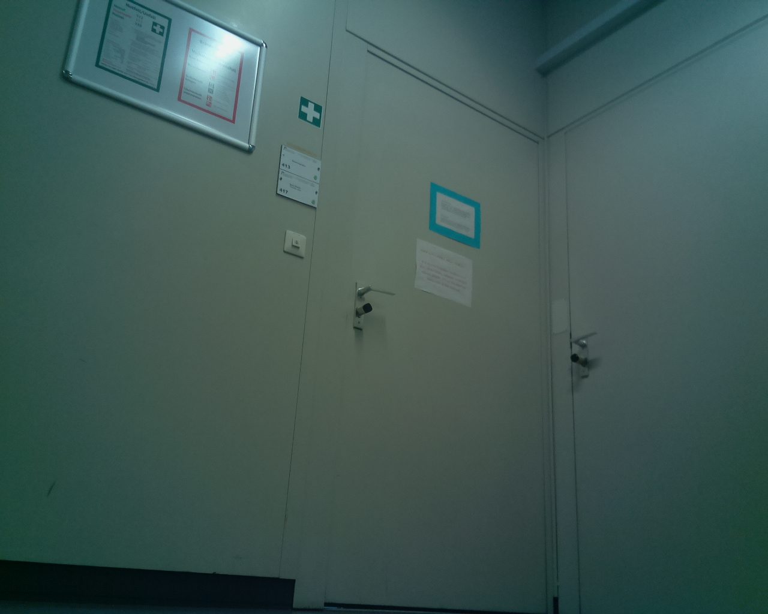
Acquired images to detect door status (open/close)
A. Image taken from inside
B. Open Door Image from Corridor
A. Closed Door Image from Corridor

Slide 11
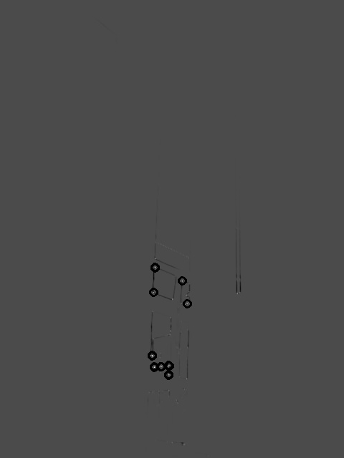
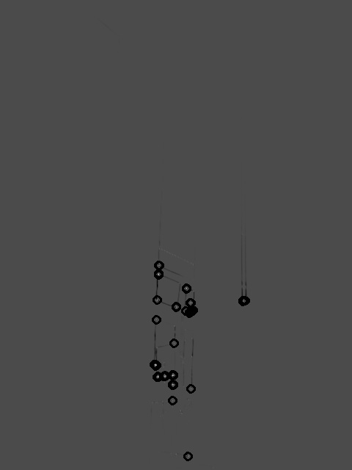
Results from OpenCV Harris Corner Detection
A. Corners with low sensitivity
A. Corners with high sensitivity

Slide 12
Various other Approaches
To better the disadvantages listed in previous slide various approaches were found and tested which are listed as follows:
Contour detection
Edge Detection
Flood Fill (or in other words, “neighborhood fill”)

Slide 13
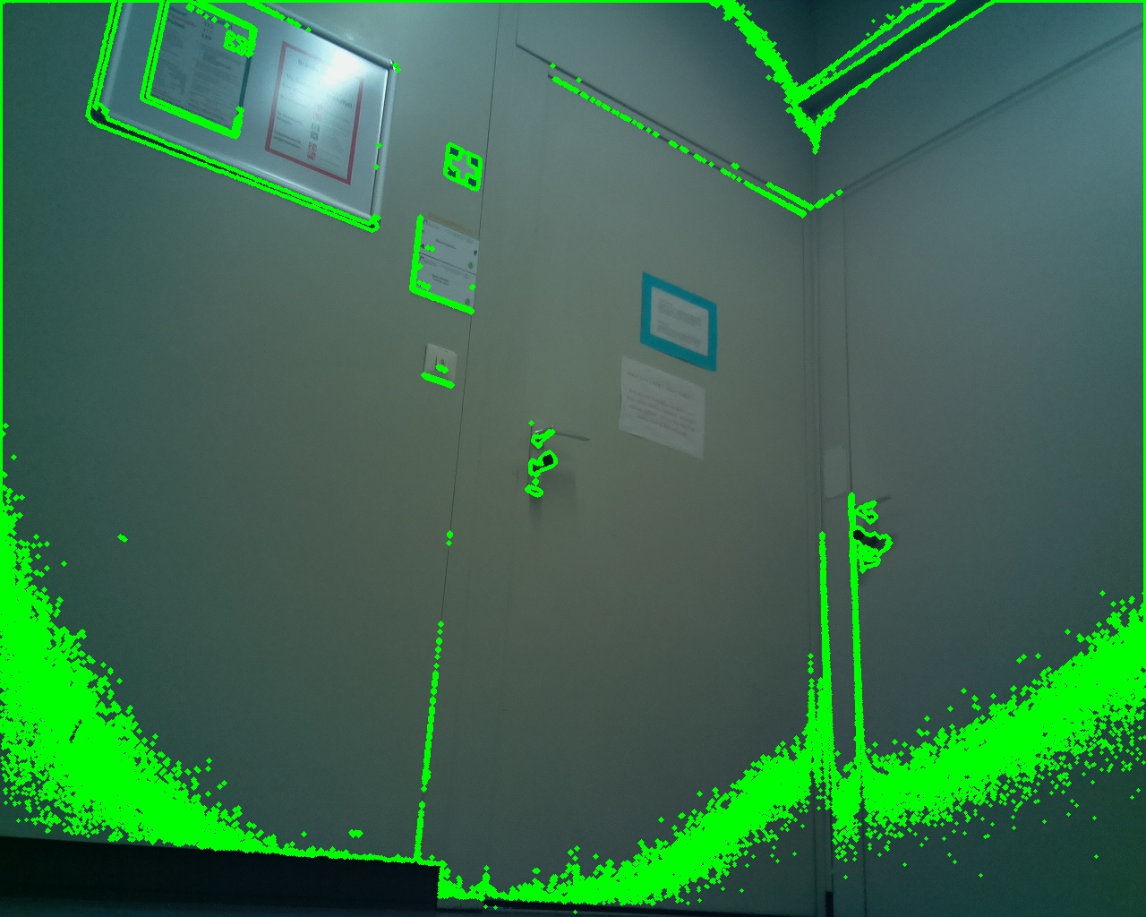
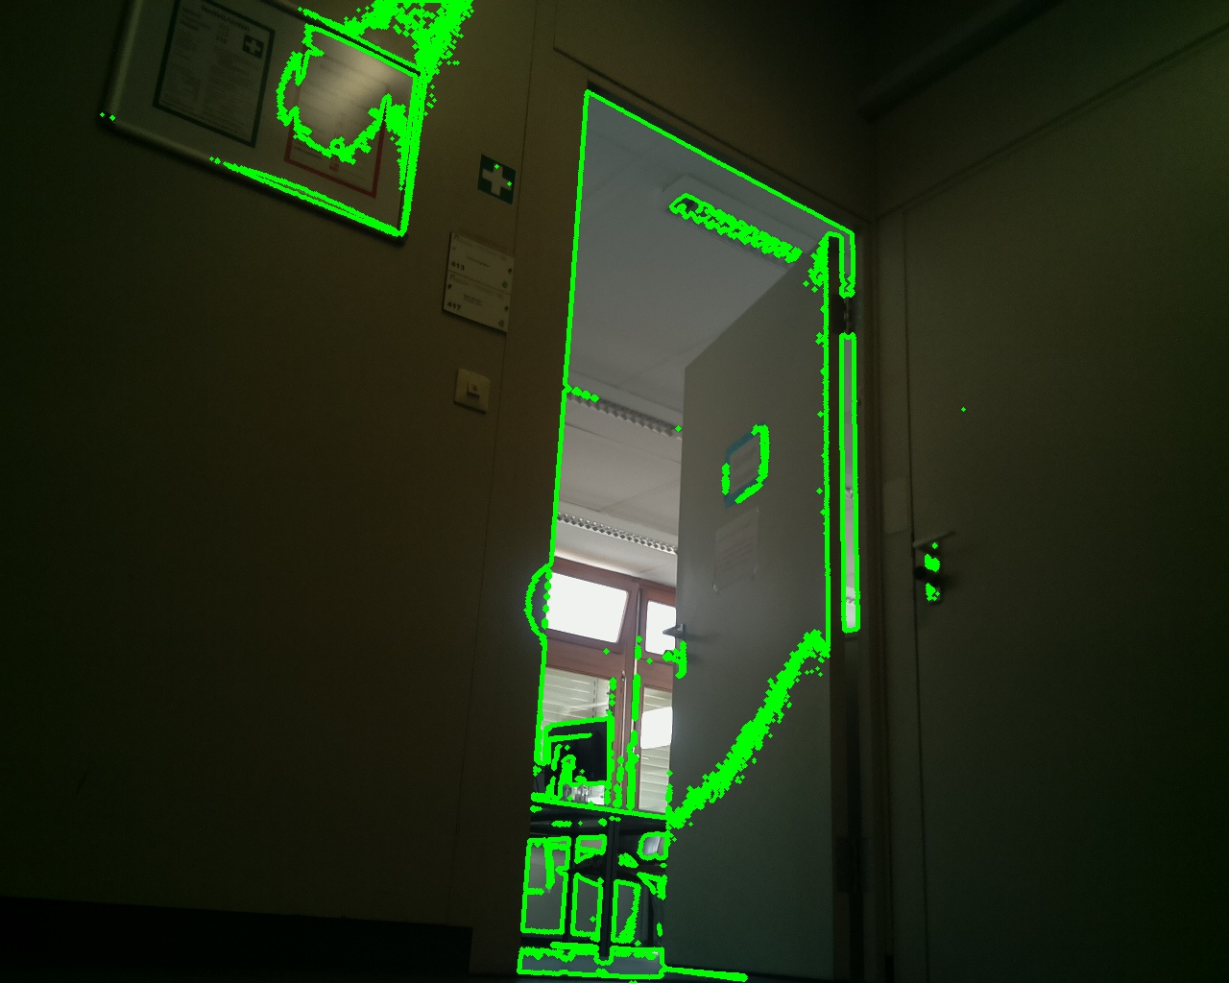
Contour Detection
This algorithm required a much high dynamic range and contrast and a simplified image (in terms of clutter in the image) to perform and thus did not prove useful for our objective.
[Cd22]

Slide 14
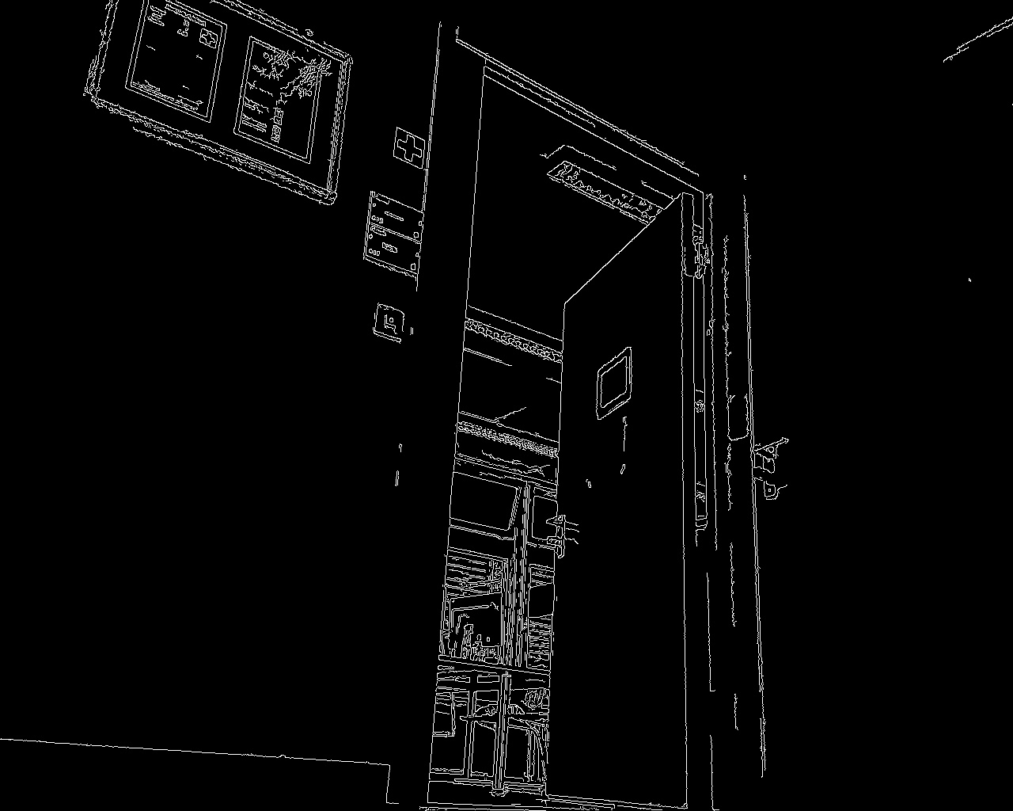
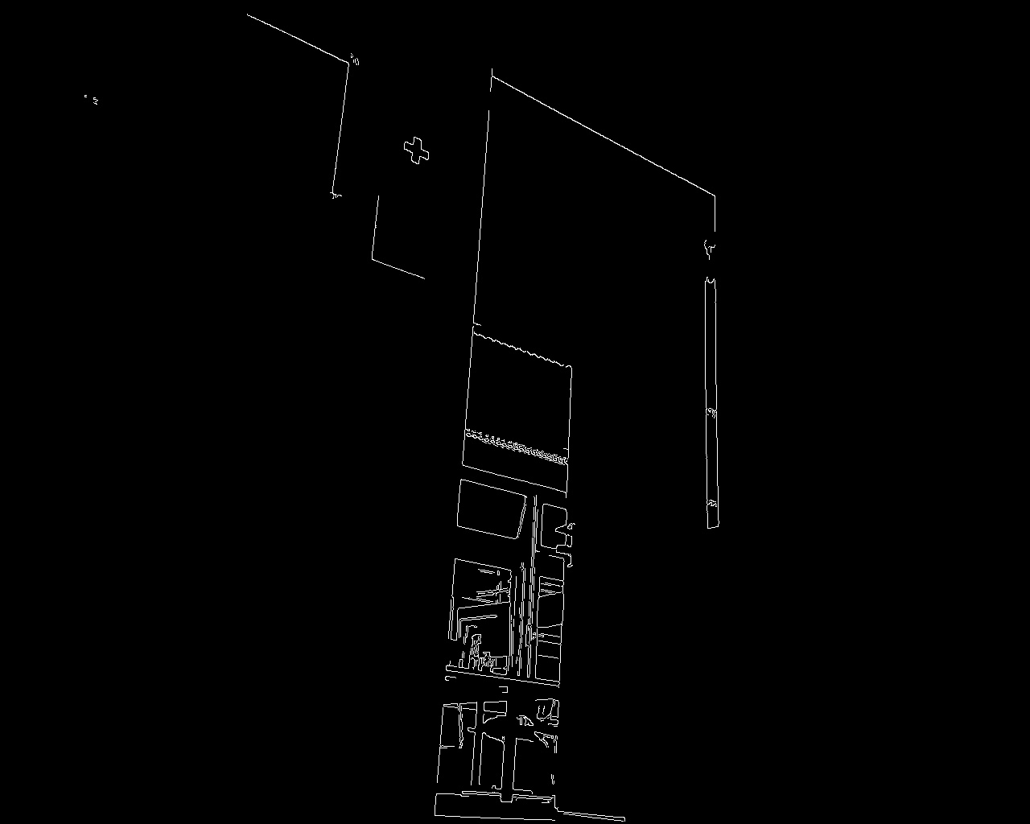
Canny Edge Detection
The logic here was to use the edge information and check if there was a box around the door. This here was again proven to be unsuccessful as whenever the door is open, the edges of the door itself were sensitive with edges found inside the box. Moreover, canny edge recognition would provide an edge map but no mathematical data which could be used further.

Slide 15
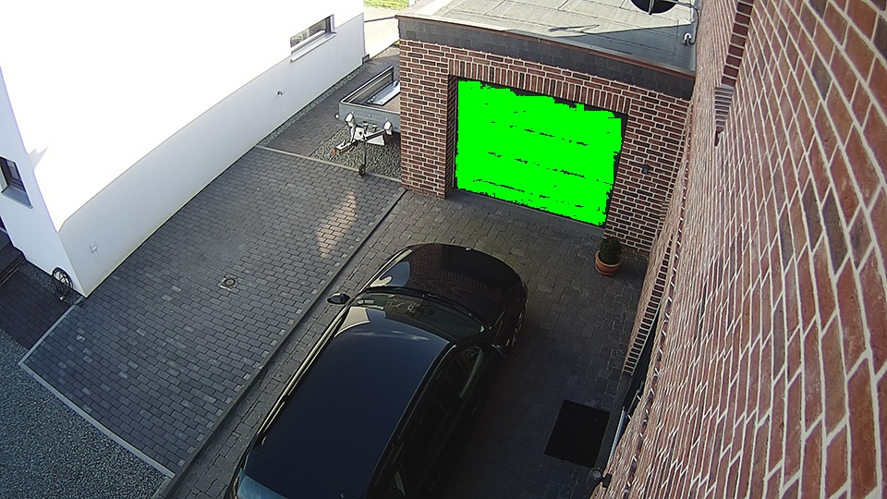
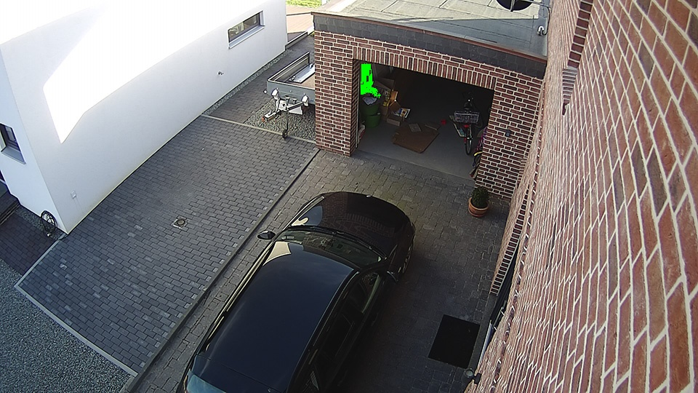
FloodFill
This is an interesting algorithm as it works based on a seed point provided. The principle here is that the neighborhood of the initial pixel (seed point), provided by the user would be checked by providing a specified window of maximum difference from the pixel being analyzed. If the neighborhood of the initial pixel is similar to the seed-point, they are filled with a color/null pixel. Then again the neighborhood of the filled pixels are checked and so on until a high contrast/edge is detected. This can be seen in an example given below. [Ff21]

Slide 16
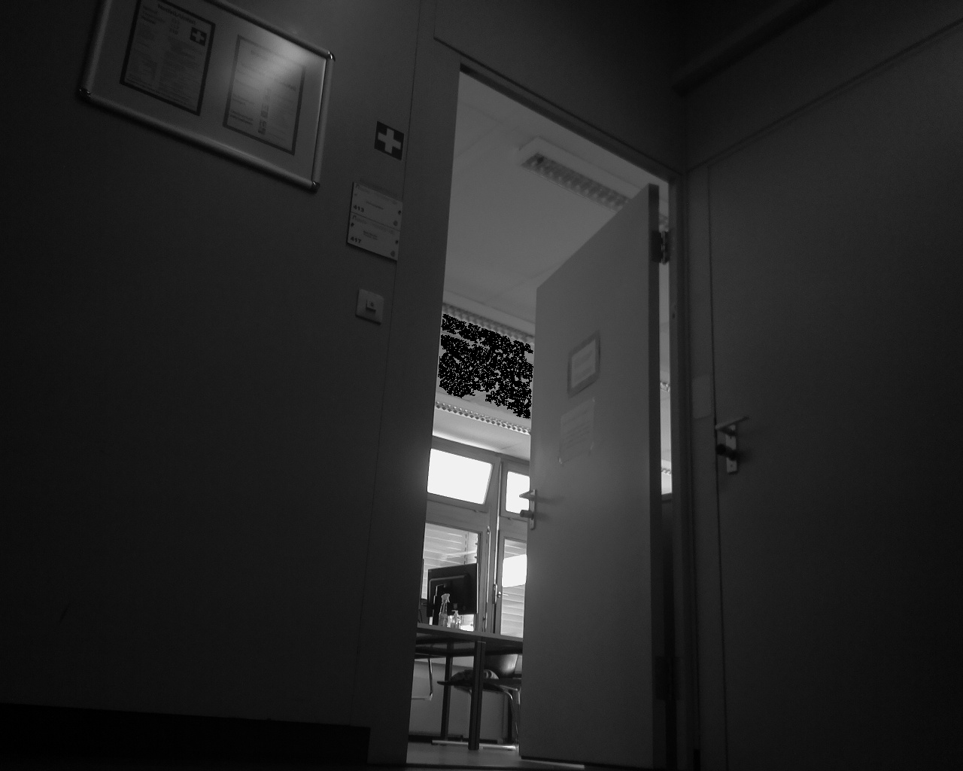
Results from FloodFill on images from corridor

Slide 17
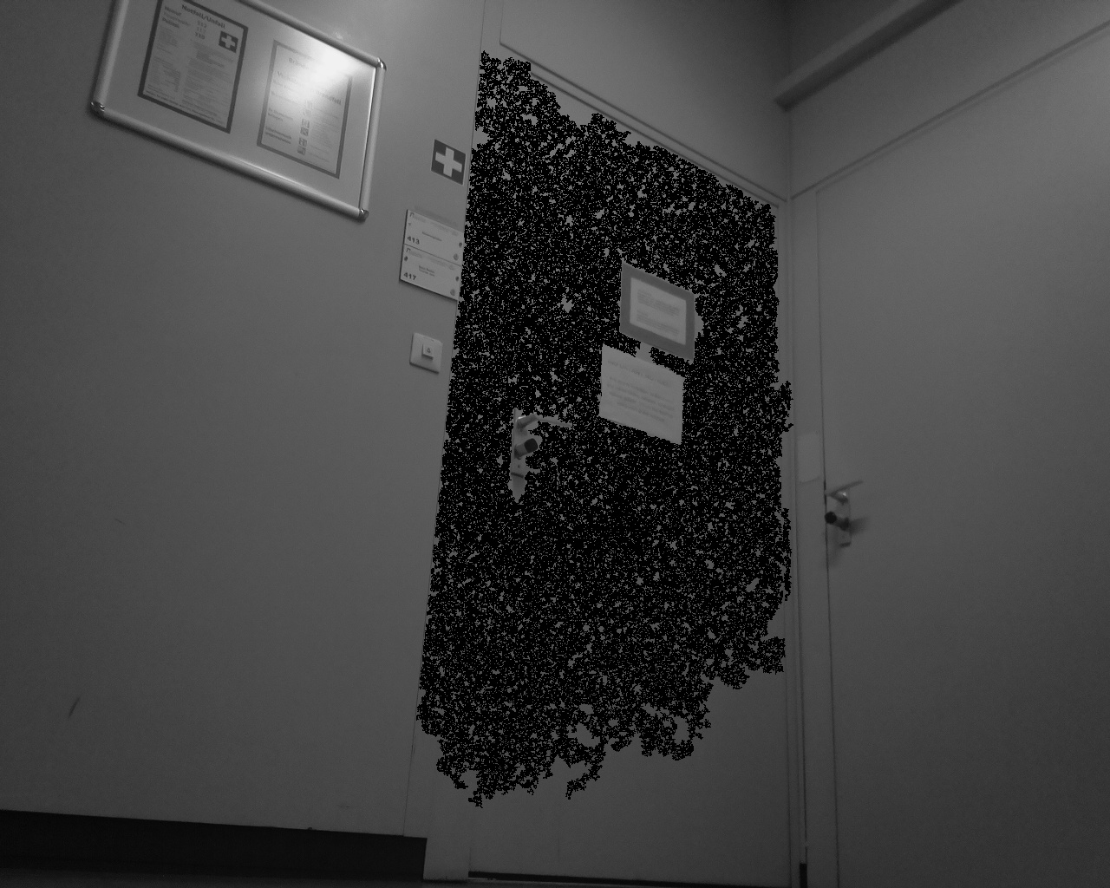
Results from FloodFill on images from corridor

Slide 18
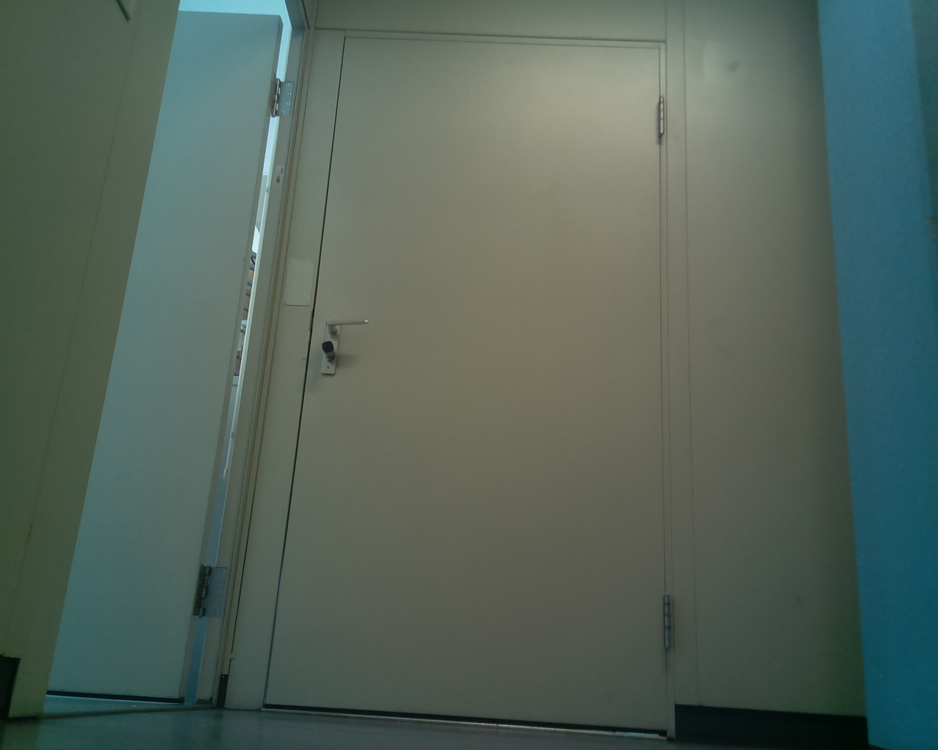
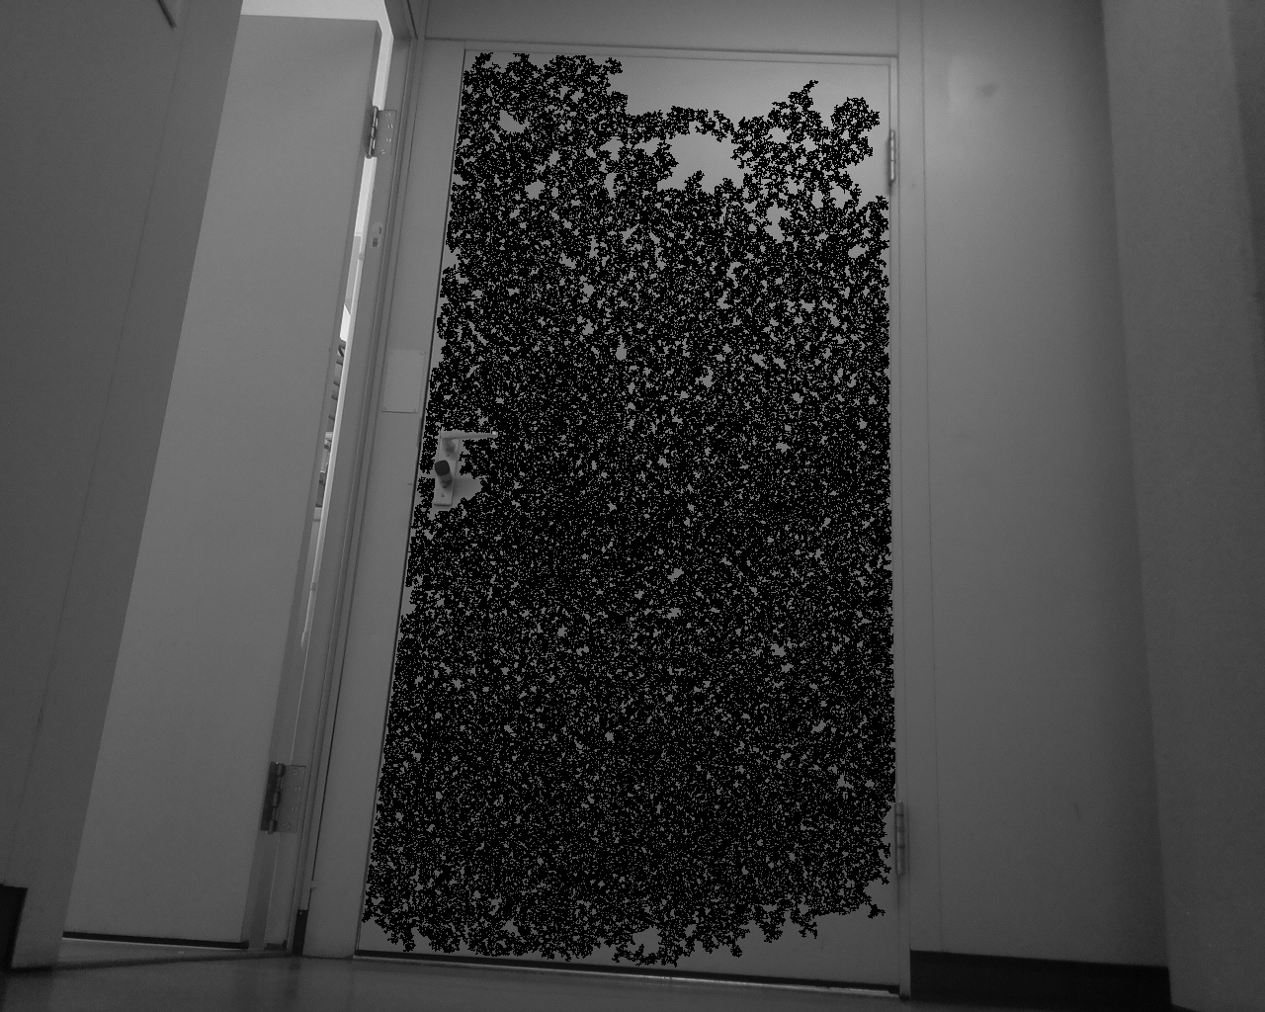
Results from FloodFill on images from corridor

Slide 19
FloodFill Approach
The initial or the start pixel here is provided as the center of the image (Height/2, Width/2).
As is seen in the first image, the clutter in the background only fills a very small portion of the image and thus the return value from this function which is actually the “no. of pixels filled by the function” is very small.
Thus thresholding this to about >10% of the image proved to be a good choice. Or in other words, if the filled region is greater than 10% of the image, it is more likely to be a door. This threshold is found experimentally.
The parameters are applied in such a way that it is most sensitive to even slight pixel changes in neighborhood and thus terminated the filling with even a slight edge.

Slide 20
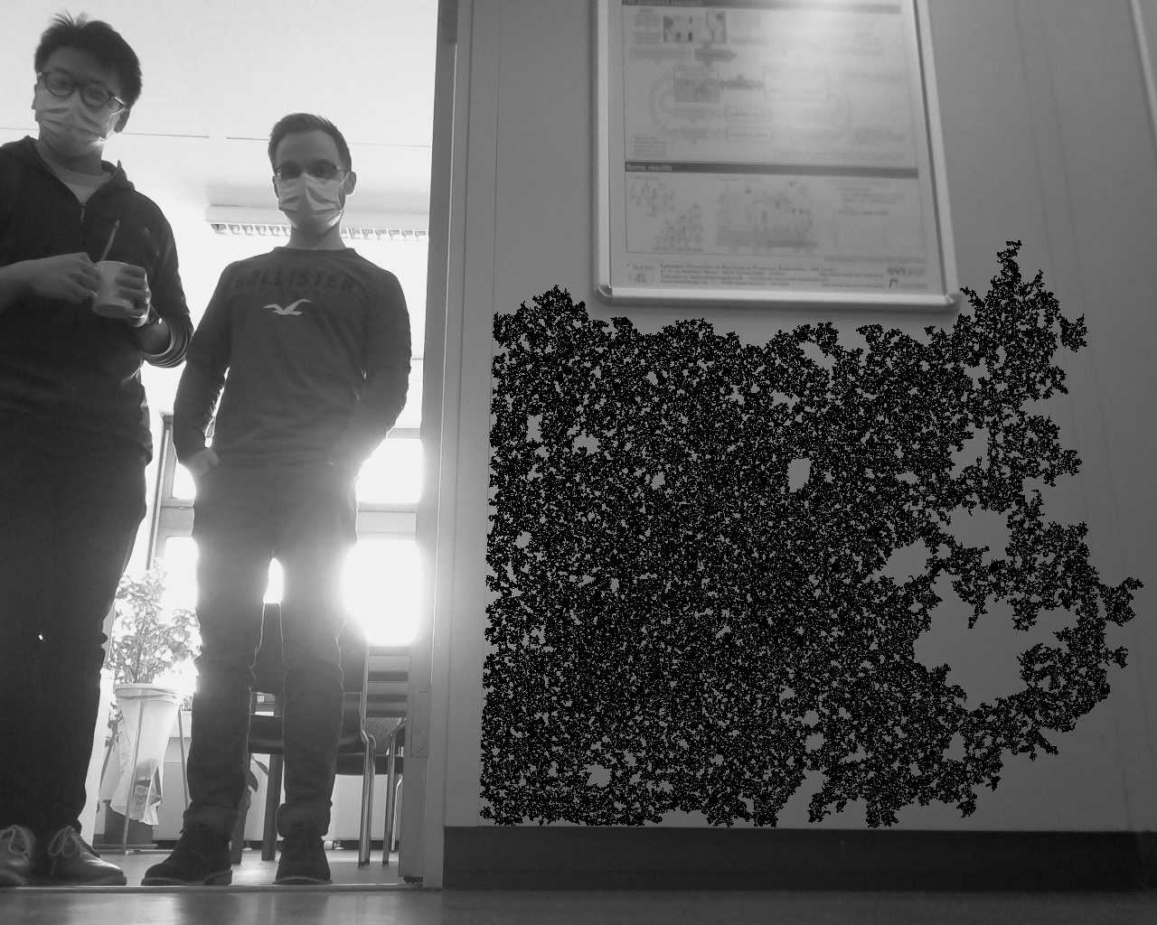
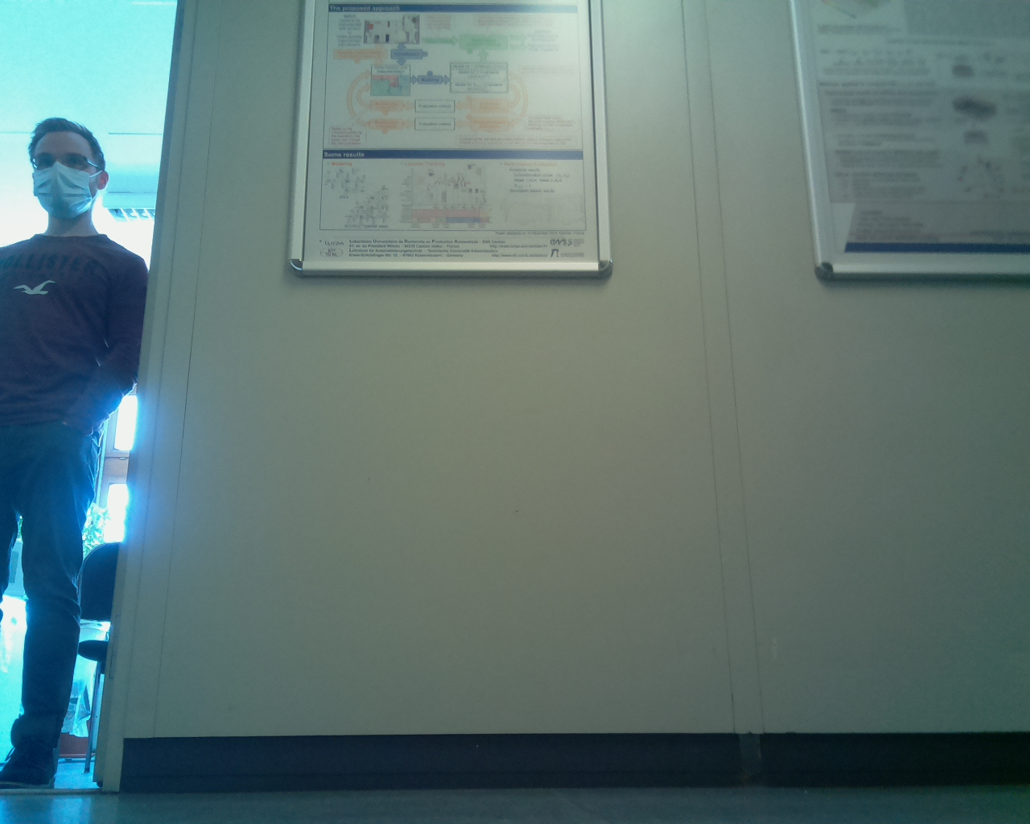
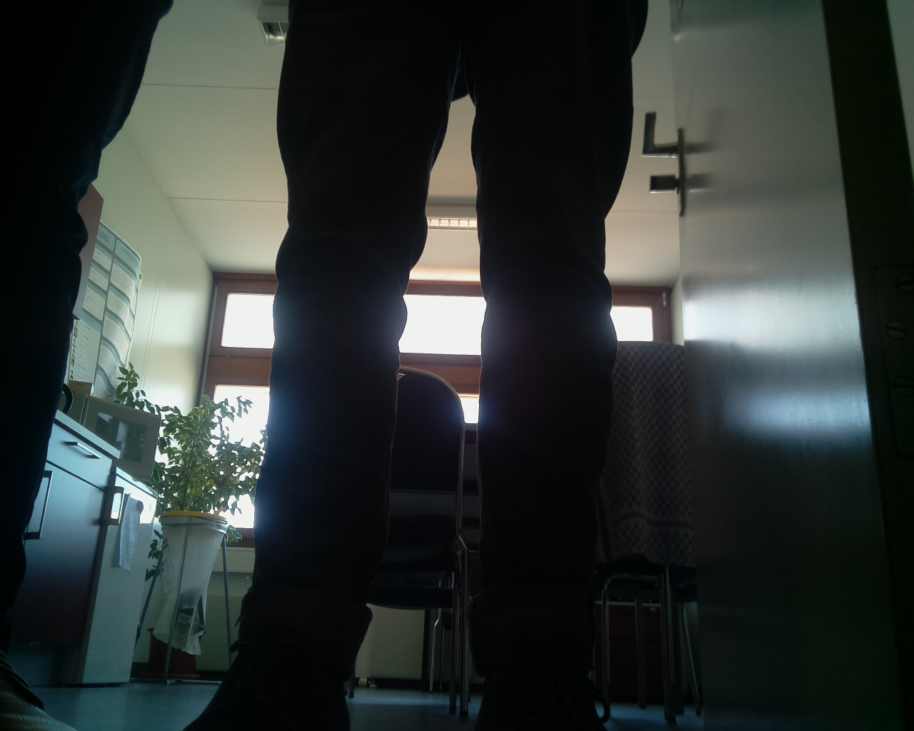
Test Run Results
Last Processed Image
Last Captured Image
Last Room Image

Slide 21
Analyzing Motion of the Robot
The Mobile Robot moves on a 4-wheel drive.
It does not have encoders/rotary potentiometers to calculate the number of motor/wheel rotations.
A proper pulse signal on all 4 wheels individually and for a specific time must be applied to achieve desired motion.
For example,
motor.SetPWMSignal(2000,2000,2000,2000) #All 4 wheels in forward motion
time.sleep(3) #3s of forward motion by giving Delay
motr.SetPWMSignal(0,0,0,0) #Stop the robot

Slide 22
Necessary Considerations for the Motion of the Robot
The robot has to move in fixed steps of motion to constantly check for doors and obstacles on its route.
Since it is not possible to determine how exactly the robot is oriented within the robot, it is better to make the robot make orthogonal turns (90 degree Left/Right) only.
This is because such motion could be verified by naked eye while testing and makes the problem simpler as will be presented in the next slides.

Slide 23
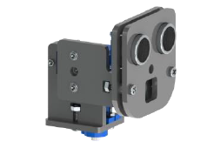
Ultrasonic Sensor for Obstacle Avoidance
Ultrasonic Sensor is one of the built-in sensors present just above the camera in the 2-servo Swivel Head.
This can be used to estimate how far the objects are from the robot’s current position.
Ultrasonic Sensor
Note: Both Camera and Ultrasonic Sensor will swivel simultaneously
Pitch
PiCamera
[Fnv22]
Yaw

Slide 24
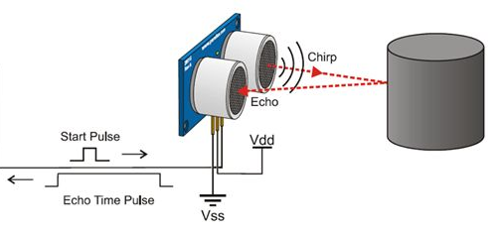
Ultrasonic Sensor Working Principle
Ultrasonic Sensor is a time-of-flight sensor which measures the time between the “chirp” signal (ultrasonic signal emitted) and the “echo” (ultrasonic signal received).
Using the equation of motion for constant velocity S=Vt, we get the object distance.
Raspberry Pi GPIO
[Us20]

Slide 25
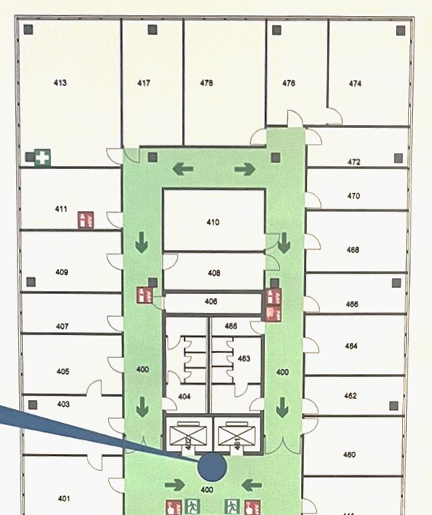
Obstacle Avoidance Algorithm
The mobile robot developed has to be deployed in the corridor where it must always remain closer to the wall on it’s right as it is made to move clock-wise along the lobby.
This constraint is necessary because of the camera Field-of-View.
The path can be seen as marked by the blue box and in clock-wise direction.

Slide 26
Obstacle Avoidance Algorithm
The idea here is to make the robot follow the wall on it’s right for the whole corridor so that it remains at a constant distance and has enough space on it’s left to click pictures and capture images of the door.
Default Case: The robot is within a tolerance from the wall on it’s right.
It was soon very clear that robot may encounter only 2 scenarios when it has to avoid obstacles/make turns:
Case I: It meets a dead end on it’s front and right (Corner case)
Case II: It has more than enough space on it’s front and left (Clearance case)

Slide 27
The Default Case
Robot Path
This is the case when there is enough space in front and within the tolerance on it’s right.
Here, the robot continues it’s normal operation of checking the doors on it’s left and moves a step ahead after each cycle.
Door Closed
Tolerance from the wall
Door open
Mobile Robot
Inner wall of the corridor
*Figures not drawn to scale

Slide 28
Case I: Corner Case
In this case, since the ultrasonic detects an obstacle in front of the robot and the wall is still on right, it is instructed to make an orthogonal left turn.
Thus each time it meets a “corner”, as depicted, it turns left and continues.
Object/ Column/ Obstacle on path
Ultrasonic detection of the corner
Robot Path
Inner wall of the corridor
*Figures not drawn to scale

Slide 29
Case II: Clearance case
Here, the robot faces 2 types of scenarios although the principle is same whether the scenario is because of an obstacle or due to valid turning point in the corridor.
The ultrasonic sensor finds clear space in front of the robot and on the right of the robot as there is no more wall.
Thus the robot make an orthogonal right turn to get back on the tolerance with the object/wall.
Robot Path
Object/ Column/ Obstacle on path
Ultrasonic detection of clear space
Inner wall of the corridor
Obstacle avoidance Scenario
*Figures not drawn to scale

Slide 30
Case II: Clearance case
Ultrasonic detection of clear space
Robot Path
Right turn in the lobby
Turn Right on Corridor Scenario
Inner wall of the corridor
*Figures not drawn to scale

Slide 31
Clearance Case Video Segment
Making an orthogonal right turn to turn right in the corridor
Turn Right on Corridor Scenario

Slide 32
Challenges in Robot Motion
The robot has no feedback mechanism to check how far it has moved or what orientation it currently stands on.
Thus making precise movements become difficult.
This is why there is a need of correction every time it moves.
The reasons may be several:
Slip in motion
Non-simultaneous signal to 4 wheels
Errors in wheel velocity sync.
Uneven braking

Slide 33
Code optimization
To overcome some hardware difficulties, the time for each step of robot motion is chosen by running various tests.
For example, a delay of 1.1 seconds gives almost an orthogonal turn but not every single time.
The code is written in a way so that it doesn’t check for doors while avoiding obstacles and thus making it efficient.
Giving proper delay times to capture images and measure distances using ultrasonic was a key to obtain sharp (blur-free) images and reduce the transient measurements respectively.
Trials to give the left/right pair of wheels a slight greater/lower velocity to correct its path was also tried but gave erratic results every time.

Slide 34
Miscellaneous Problems
Here are a few problems that doesn’t have much effect on the objective but ought to be acknowledged to achieve sound performance.
The dual-servo swivel head has a constant jitter if left powered and it can lead to bad images and measurements. Un-powering them after a desired position is achieved is better as there is not much stall torque required to hold the head in place.
The battery consumption is pretty high while using PWM signals (for Servo and DC Motors) and so it would be better to remove additional power consuming sensors like infrared.
The slip in the wheels is almost inevitable as it was observed on a rough carpet surface.

Slide 35
Conclusion
FloodFill approach works very well provided that the images are blur-free taken such that a significant region in the image includes door.
The robot can operate in the corridor and detect open doors but since the motion of robot is not precise, it is difficult to return to the same path.
But all in all, the decision making of the robot and the ability to autonomously move around the corridor and detect door is very well established with inclusion of a new way (ultrasonic sensor) to get feedback for motion.
The robot can avoid obstacles, detect closed/open doors and knows when to turn in the lobby.

Slide 36
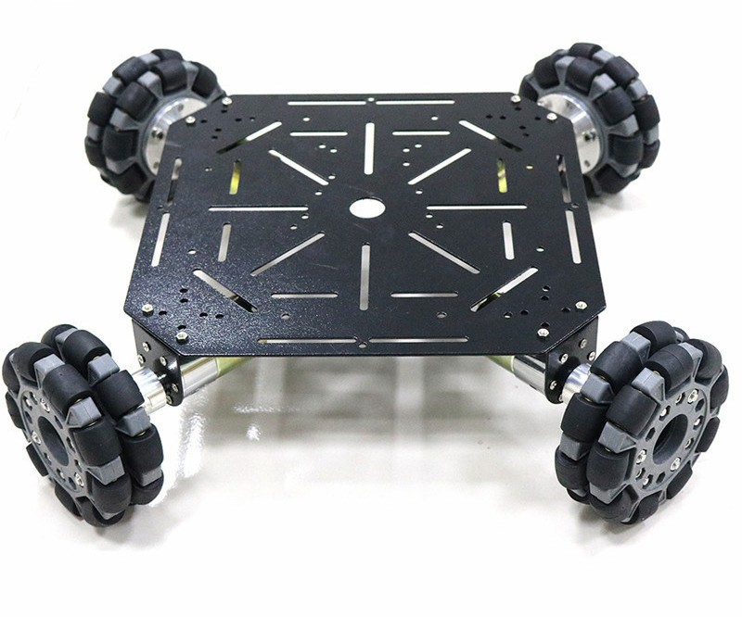
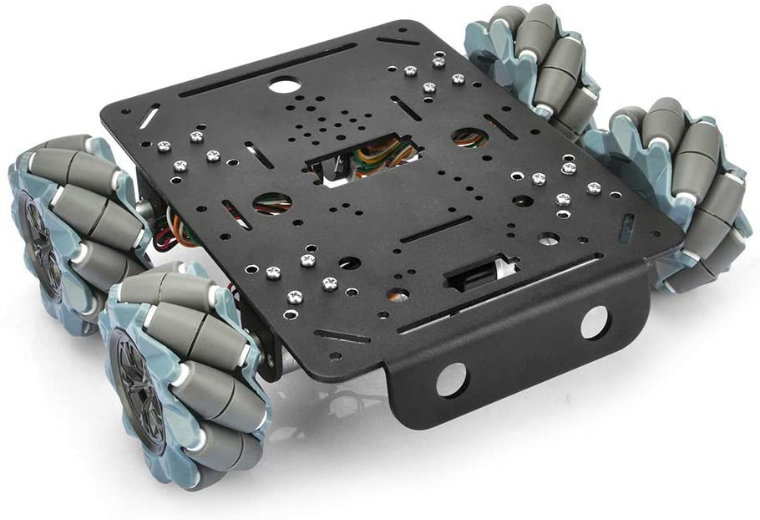
Future Scope
Possible future works to improve the motion:
It would be better to use an Omni-wheel drive or Mecannum wheels so as to allow the robot to freely move in all directions without having to make turns.
Also encoders are greatly important to identify the position and orientation of the robot.
Visual Odometry is another scientific field which plays with images to find distances.

Slide 37
References
[Fnv22] | https://github.com/Freenove/Freenove_4WD_Smart_Car_Kit_for_Raspberry_Pi/blob/master/Tutorial.pdf
[OcvM20] | https://www.analyticsinsight.net/opencv-vs-matlab-which-is-best-for-successful-computer-vision-project/
[Ff21] | https://stackoverflow.com/questions/11327835/check-if-a-physical-door-is-opened-or-closed-with-opencv
[Us20] | https://www.c-sharpcorner.com/UploadFile/167ad2/how-to-use-ultrasonic-sensor-hc-sr04-in-arduino/
[Jcr98] | The Image Processing Handbook: Third Edition. University of Michigan, 1998. ISBN: 0849325323
[Cd22] | https://learnopencv.com/contour-detection-using-opencv-python-c/

Slide 38
Thank You!
I acknowledge and thank the support of the Chair of AT+ in giving me the opportunity to work on such an interesting project. I thank Prof. Dr. Ping Zhang for this opportunity and contribution towards the field. I also thank M.Sc. Dina Mikhaylenko for assisting in all the challenges I faced during the study and project.

